Slide 1







Google Glass: The Rise and Fall of a Revolutionary Product and its Launch Decisions
TEAM: 2
INFM612 - Final Project Presentation
Dr. Ping Wang
Jianbo
Zhang
Srikanth Parvathala
Abdul Rehman Shaik
Steicy Singh
Tanya Gupta
Vijay
Arni

Slide 2
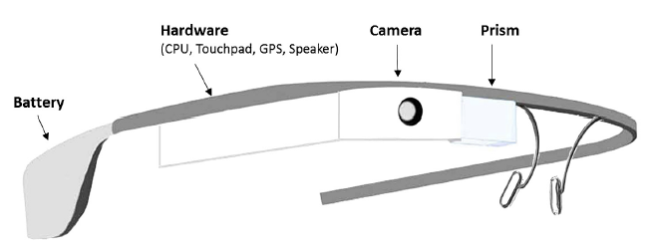
What is Google Glass？
Google Glass Program
Google Glass is a wearable technology developed by Google X, which was first introduced in 2012.
It is essentially a pair of smart glasses with an integrated heads-up display (HUD) and augmented reality (AR) capabilities.
The device is designed to be unobtrusive and lightweight, making it comfortable for users to wear throughout the day.
.
Functionality of smart glasses from Google Inc. and Martin Missfeld (CC-BY).
Rauschnabel, P. A., Brem, A., & Ivens, B. S. (2015). Who will buy smart glasses? Empirical results of two pre-market-entry studies on the role of personality in individual awareness and intended adoption of Google Glass wearables. Computers in Human Behavior, 49, 635–647. https://doi.org/10.1016/j.chb.2015.03.003

Slide 3
The Development Team Behind Google Glass
Research & Development Team
Project Affiliation: Google X(now called X Development)
Member Characteristics: Diverse, with expertise in various fields, including software engineering, hardware engineering, industrial design, and user experience.
Key Members:
Babak Parviz: Director of the Google Glass project
Sergey Brin: Responsible for product promotion and technology demonstration
Thad Starner: Technical Supervisors and Managers
Isabelle Olsson: Industrial Designer For Google Glass
Steve Lee: Product Manager
.

Slide 4

Google Glass features
Camera : Built-in camera that allows users to take photos and record videos hands-free.
Voice Commands : Users could interact with Google Glass using voice commands(“OK GLASS”)
Third Application : Google Glass supports a variety of apps or "Glassware" that extend the functionality of the device. It supports apps such as, Google mail, Google Map, Facebook, Twitter.etc
Display : The primary feature of Google Glass is its transparent display, which projects digital content directly into the user's line of sight.
Connectivity : Google Glass can be connected to the Internet via Wi-Fi, or connected together with a smartphone via Bluetooth.
Sensors : such as gyroscope and compass for head tracking and gesture recognition.
.
Notes:
Camera
Built-in camera that allows users to take photos and record videos hands-free.
Voice Commands
Users could interact with Google Glass using voice commands(“OK GLASS”) to perform various tasks, such as making a phone call, sending a text message, or searching the web.
Third Application
Google Glass supports a variety of apps or "Glassware" that extend the functionality of the device. Apps range from productivity tools and social media integration to fitness trackers and news readers. Such as, Google mail, Google Map, Facebook, Twitter.etc
Display
The primary feature of Google Glass is its transparent display, which projects digital content directly into the user's line of sight.
Connectivity
Google Glass can be connected to the Internet via Wi-Fi, or connected together with a smartphone via Bluetooth.
Sensors
such as gyroscope and compass for head tracking and gesture recognition. For example, users can interact with digital content through head movements

Slide 5
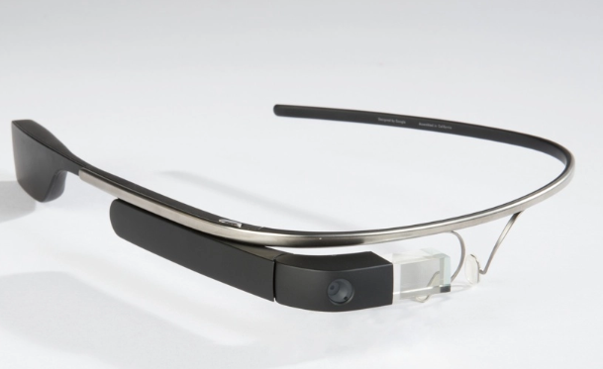
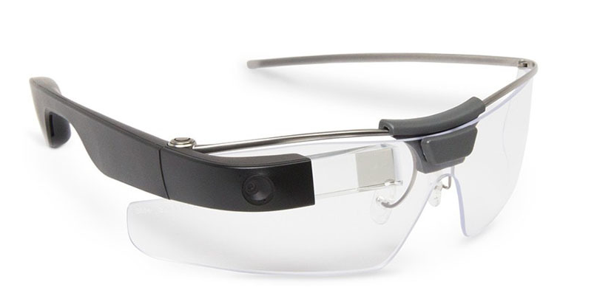
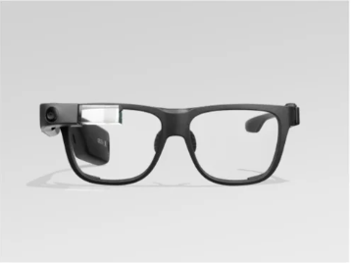
The History of Google Glass
Year: 2013
System: Android 4.0.4
Version:The Explorer Edition(1st version of Google Glass)
Environment and User: Developers and early Testers
Year: 2017
System: Android 5.1.1
Version:Enterprise Edition of Google Glass
Environment and User: Using in workplaces and industrial settings.
Benefits: More robust design and longer battery life
Year: 2019
System: Android 8.0
Version:Glass Enterprise Edition 2
Environment and User: Using in workplaces and industrial settings.
Benefits: Upgraded processor, improved camera quality, and support for Google's Android Enterprise Mobile Device Management platform.

Slide 6
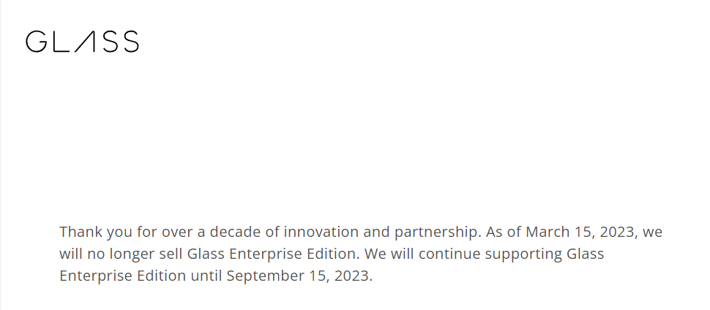
The Significance of Google Glass
Innovation: Google Glass was a unique and innovative product that pushed the boundaries of what was possible in wearable technology.
Experimentation: Google Glass was an experimental product that allowed Google to test new ideas and technologies in a real-world setting.
Potential: Despite its limitations, Google Glass had the potential to be a game-changing technology in several industries, including healthcare, manufacturing, and logistics.
Google Glass brings the market or the significance of technology
.
“Google has stopped selling its Glass Enterprise smart glasses, the company announced on Wednesday on its website. It will also stop supporting its software in September, the company said”(CNBC, 2023/03/15)
Influencing Factors: privacy concerns, limited market demand, and product limitations.
Enterprise Edition – Glass. (n.d.). Glass. https://www.google.com/glass/start/

Slide 7
Launch Strategies and Other Decisions
*1
EXCLUSIVITY
2
SOCIAL MEDIA
3
DEVELOPER STRATEGY
Highlights
Exclusive program for select individuals to purchase Google Glass
Encouraging users to share their experiences on social media
Hosting events to expand the functionality of Google Glass
Facts & Figures
"Google Glass Explorer" allowed selected individuals to purchase the device for $1,500.
Glass Explorers to share their experiences social media using the hashtag #throughglass
Series of events called "Glass Foundry" which encouraged developers to create new applications.
Specifics
Invite-only program. Limited to a small number of individuals
Social media helped to establish Glass as a consumer product, not just a prototype.
Events featured expert speakers and workshops on developing for Google Glass.
Impact
Successful in creating a sense of exclusivity.
Around 10,000 units were sold during this phase.
Google Glass achieved over 1 billion media impressions. It built a community of Glass.
Helped to expand the functionality of the device. Attracted 4,000+ developers from diverse industries

Slide 8
Launch Strategies and Other Decisions
*4
MEDIA
5
PARTNERSHIP
6
DEMONSTRATION
Highlights
Generating media coverage through demos, reviews, and interviews
Partnering for new designs and Glass-specific applications
Creating "Glass Guides" for live demonstrations of Google Glass
Facts & Figures
Featured in high-profile publications such as The New York Times and Forbes.
Partnered with companies,Luxottica and DVF (a fashion designer), to create new designs
Demonstrations were held at various events & locations, such as coffee shops,
Specifics
Luxottica partnership reportedly costed Google over $300 million.
Ray-ban, TAG Heuer and Intel got involved.
Invested heavily in Glass Guides program, with reports suggesting that each Guide costed Google over $100,000/ year.
Generated over 100,000 articles in the media
Impact
Gained a lot of media attention.
YouTube channel had over 34 million views.
Helped to position the product as a fashionable accessory, rather than just a piece of technology.
Helped to position Google Glass as a cutting-edge, futuristic device.

Slide 9
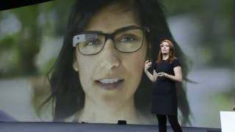
Business Outcome of Google Glass (Explorer Edition, 2013-15)
2013 Metrics
LEGENDS
IVT
Very High
IVT : Investment
SL : Sales
CSAT:Customer Satisfaction
CI
SL
Low
PL
CSAT
Medium
CL
2014 Metrics
IVT
High
CI
SL
Medium
PL
CSAT
Low
CL
2015 Metrics
IVT
Medium
CI
SL
Low
PL
CSAT
Low
CL

Slide 10
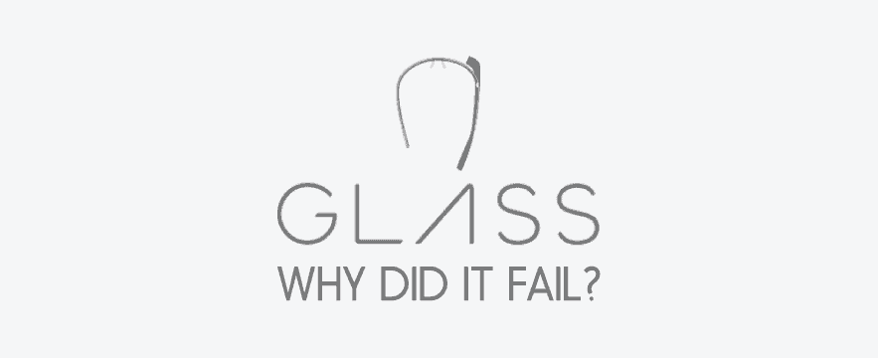
The Demise of Google Glass
.
Google Glass was not rejected by society because of its technological inadequacy, but because of its impact on social interactions and privacy perceptions as a socio-technical artifact. The engineers who developed it failed to design the human-technology interface properly, which led to the backlash against it and its eventual failure.

Slide 11
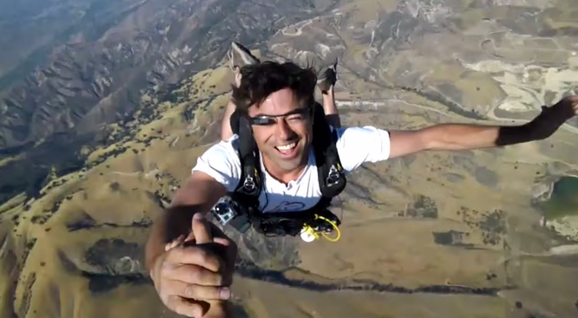

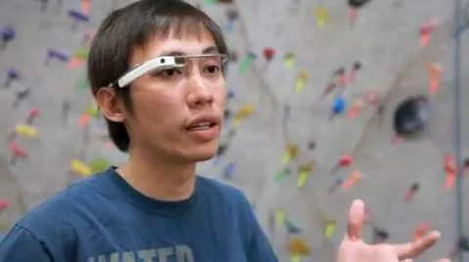
Reason behind the Glass’s Failure
Product Looking for a Market
Lack of clear value proposition: It had several interesting features, such as voice commands and augmented reality, but it was not clear how these features would translate into real-world use cases.
Primarily marketed to developers and early adopters who were interested in experimenting with new technology. On on the other hand, high price points pushed them away
.
Levy, P. (n.d.-a). Google Glass finally cracks it: it was a product looking for a market. The Conversation. https://theconversation.com/google-glass-finally-cracks-it-was-a-product-looking-for-a-market-36440

Slide 12
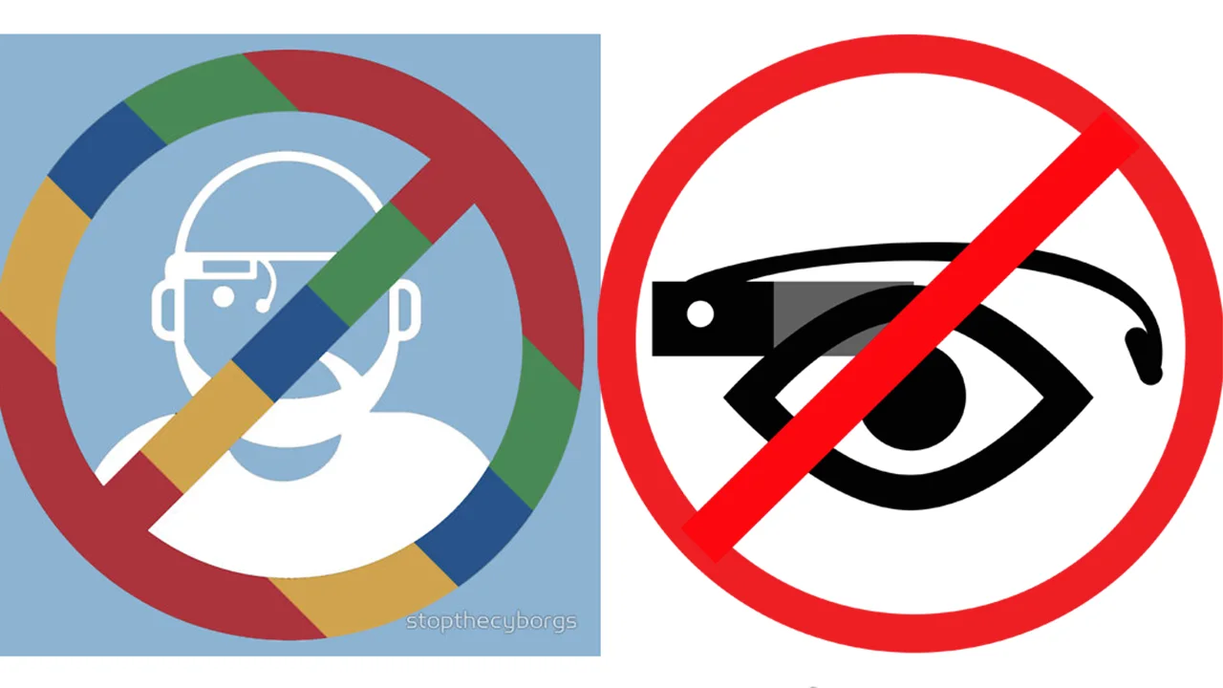
Reason behind the Glass’s Failure
Privacy Concerns
Lack of understanding with the new technology.
More invasive than any other recording technology as bystanders or peers cannot tell if they are being recorded or not.
Concerned about the inability to control when they are connected and “on”.
.
Kelly, H. (2013, December 12). Google Glass Users Fight Privacy Fears | CNN business. CNN. https://www.cnn.com/2013/12/10/tech/mobile/negative-google-glass-reactions

Slide 13
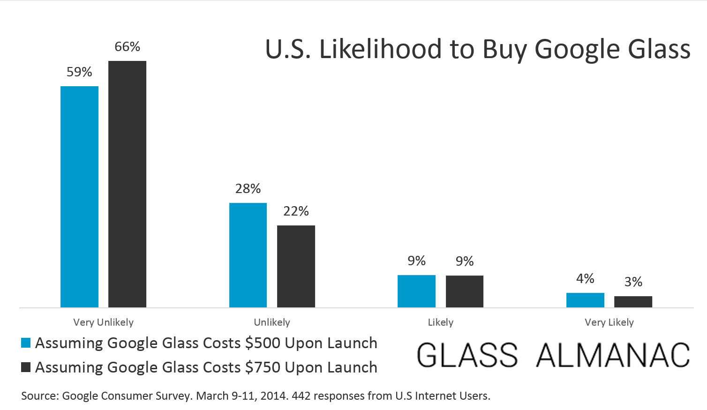
Reason behind the Glass’s Failure
High Price Point
Google Glass was priced at $1,500 when it was released in 2013, making it a high-end luxury product.
According to a study conducted by BI Intelligence, only 10% of consumers were interested in buying Google Glass at its launch.
This price point put the device out of reach for middle class consumers, and it also made it difficult for developers to create apps that would be profitable.
.
Glass Almanac. (2014, September 25). 12 percent of Americans likely to buy Google Glass at $750 price point [Study]. https://glassalmanac.com/12-percent-americans-buy-google-glass-750-dollars/

Slide 14
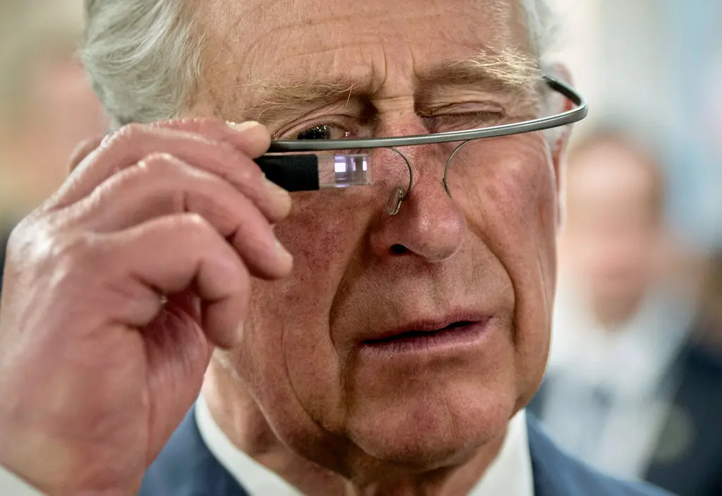
Reason behind the Glass’s Failure
Poor Functionality & Design
While Google Glass had several interesting features, it was not clear what it could do that a smartphone could not.
Additionally, the device had several technical limitations, such as a short battery life and a small screen that was difficult to read in bright sunlight.
Many critics also criticized the design of Google Glass, stating that it was bulky and unappealing. The device was also seen as a status symbol or a fashion accessory, rather than a practical tool.
.
Prince Charles in 2014.Credit...Paul Chiasson/The Canadian Press, via Associated Press

Slide 15

.
Decisions and Strategies for a Better Google Glass

Slide 16

Decisions and Strategies Google Could Have Employed
Marketing
Target audience
Feature enhancement
Collaboration with KOLs
.
2. Developer ecosystem
Device innovation
Support programs
User-base expansion
3. Privacy policies
Privacy controls
Camera shutter
Audits

Slide 17
Decisions and Strategies Google Could Have Employed
4. Price Strategy
Pricing hierarchies
Financing options
.
Google's competitors, such as Facebook, Apple, and Microsoft, are making substantial investments in Augmented Reality devices.
Google itself could adopt similar strategies to enhance the success of their future AR devices.
5. User-experience Research
Validation of market research
Surveys and Interviews
A/B Testing
6. Design
User-friendly design
Variants in enterprise edition
Launch of AR glasses

Slide 18
REFERENCES
APPENDICES
Enterprise Edition – Glass. (n.d.). Glass. https://www.google.com/glass/start/
Gross, A. (2014, March 4). What’s the Problem with Google Glass? The New Yorker. https://www.newyorker.com/business/currency/whats-the-problem-with-google-glass
Heath, A. (2022, January 20). Google is building an AR headset. The Verge. https://www.theverge.com/2022/1/20/22892152/google-project-iris-ar-headset-2024
Kelly, H. (2013, December 12). Google Glass users fight privacy fears. CNN. https://www.cnn.com/2013/12/10/tech/mobile/negative-google-glass-reactions/index.html
Levy, P. (n.d.-a). Google Glass finally cracks: it was a product looking for a market. The Conversation. https://theconversation.com/google-glass-finally-cracks-it-was-a-product-looking-for-a-market-36440
Negative Google Glass sentiment raises questions for marketers | Marketing Dive. (n.d.). https://www.marketingdive.com/ex/mobilemarketer/cms/news/software-technology/18486.html
Notes:
We need to mention in our slides that it’s a 3 tier approach that we have come up with proper timelines and financing etc

Slide 19
REFERENCES
APPENDICES
Rauschnabel, P. A., Brem, A., & Ivens, B. S. (2015). Who will buy smart glasses? Empirical results of two pre-market-entry studies on the role of personality in individual awareness and intended adoption of Google Glass wearables. Computers in Human Behavior, 49, 635–647. https://doi.org/10.1016/j.chb.2015.03.003
Tuffley, D. (n.d.). See change: is Google Glass all it’s cracked up to be? The Conversation. https://theconversation.com/see-change-is-google-glass-all-its-cracked-up-to-be-13268
Wikipedia contributors. (2023). Google Glass. Wikipedia. https://en.wikipedia.org/wiki/Google_Glass
Yoon, C. (2018, August 31). Assumptions that led to the failure of Google Glass. Medium. https://medium.com/nyc-design/the-assumptions-that-led-to-failures-of-google-glass-8b40a07cfa1e#:~:text=Google%20Glass%20would%20have%20been,the%20solutions%20Glass%20would%20provide
Notes:
We need to mention in our slides that it’s a 3 tier approach that we have come up with proper timelines and financing etc

Slide 20
THANK YOU!
Notes:
We need to mention in our slides that it’s a 3 tier approach that we have come up with proper timelines and financing etc

